Slide 1
Benefits Apply Tool
github.com/abitabir/BenefitsApplyTool

Slide 2
Overview
A software system for benefit applications has a three-layer architecture:
Presentation Layer: Web UI using JavaScript, HTML and CSS
Business Layer: Java code for data validation and business logic
Data Layer: RDBMS, primarily queried with SQL
Key Objective: Prototype a Participant Data Model to store Participant details, focusing on the Business Layer
Scope: Presentation and Data layers are out of scope for this project but should be considered for future expansion and flexibility
OOP Principles: Design classes with constructors, attributes, properties and methods using Java
Testing: Design a suite of JUnit tests for functionality and service support

Slide 3
Design Approach
Utilised UML modelling
Aiming to reduce the amount of costly changes later on in the software development life cycle
Applied modern OOP principles:
Encapsulation (private fields with public getters/setters)
Inheritance (Evidence superclass)
Polymorphism (reusing Evidence for different types)
Composition (Participant contains multiple Evidence objects)
Follows SOLID principles:
Single Responsibility – Each class focuses on one task (clean separation of concerns)
Open/Closed Principle – Easy to extend without modifying existing code
Liskov Substitution – Evidence subclasses are interchangeable

Slide 4
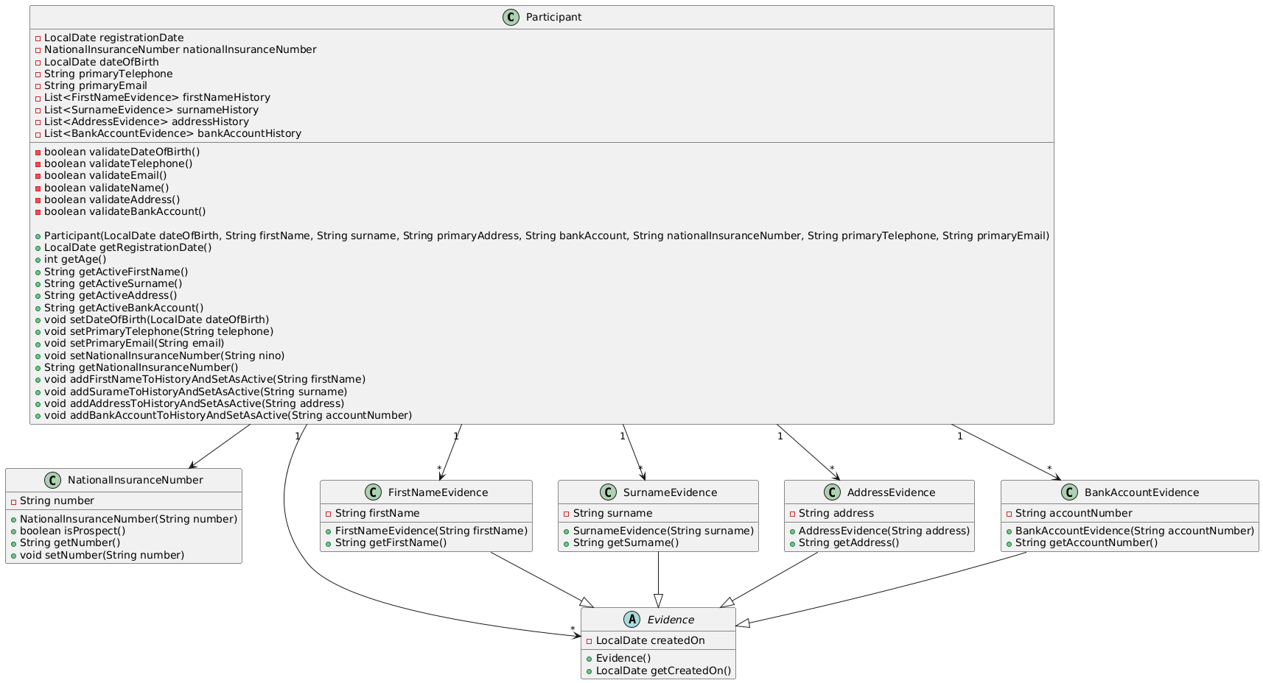
Class Diagram & PlantUML Code

Slide 5
Class Diagram

Slide 6
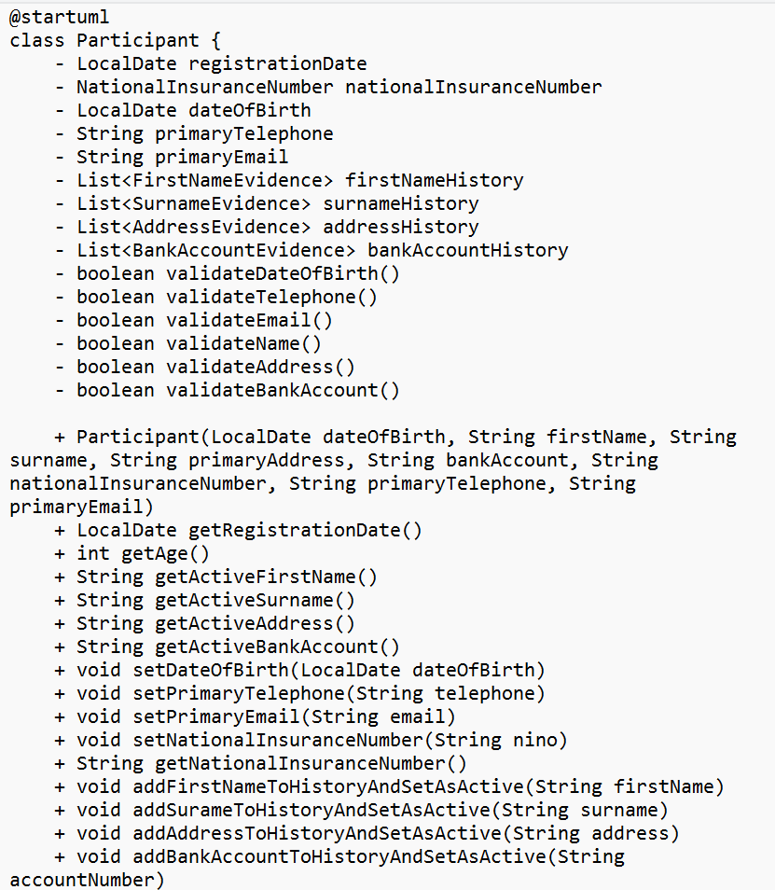
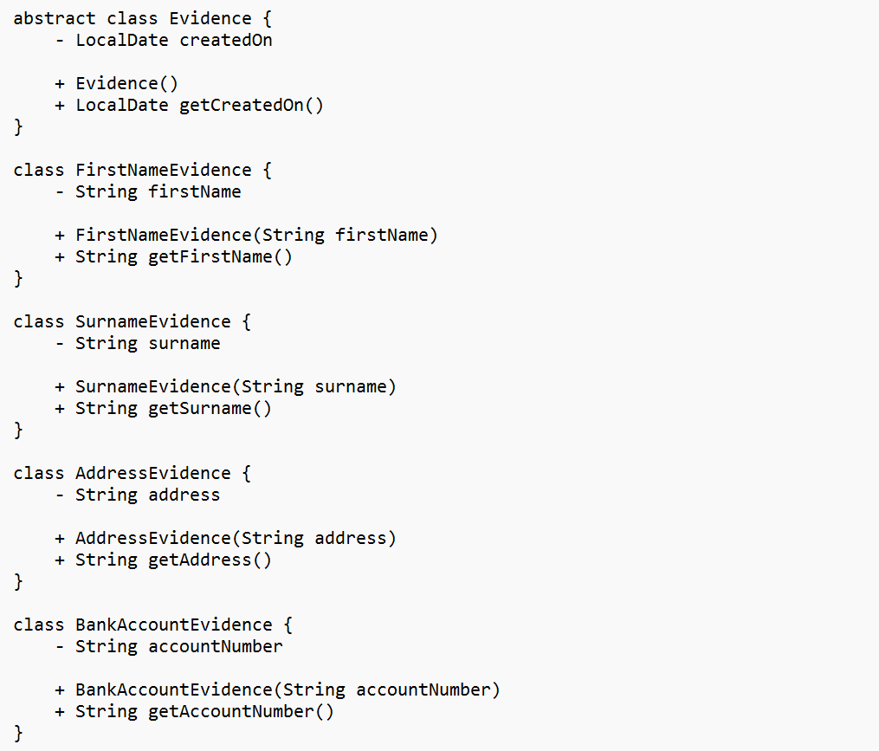
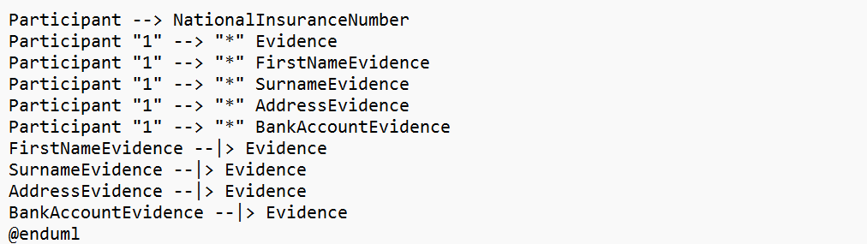
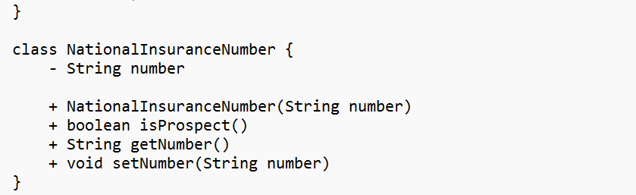

Slide 7
Class Diagram
Classes:
Participant – Core entity holding key details
NationalInsuranceNumber – Separate class to handle NINO and prospect status
Evidence – Abstract class for tracking historical data
FirstNameEvidence, SurnameEvidence, AddressEvidence, BankAccountEvidence – Concrete classes extending Evidence
Relationships:
One-to-one from Participant to NationalInsuranceNumber
One-to-many from Participant to Evidence (including FirstNameEvidence, SurnameEvidence, AddressEvidence, BankAccountEvidence)
FirstNameEvidence, SurnameEvidence, AddressEvidence, BankAccountEvidence inherit from Evidence

Slide 8
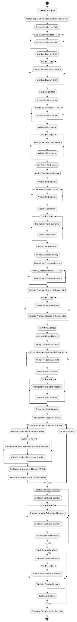
Activity Diagram & PlantUML Code

Slide 9
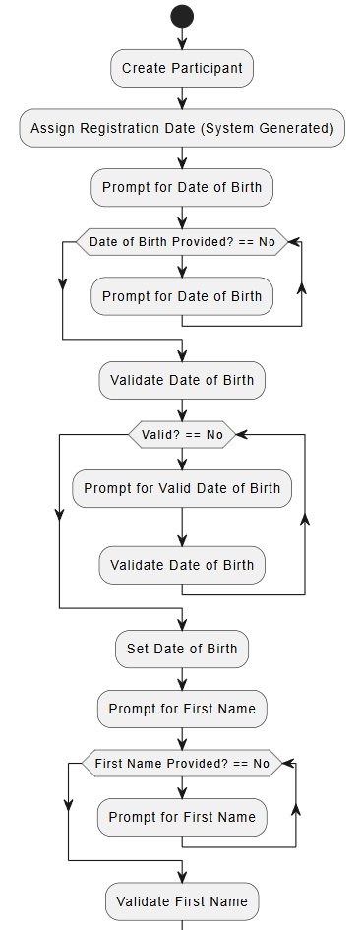
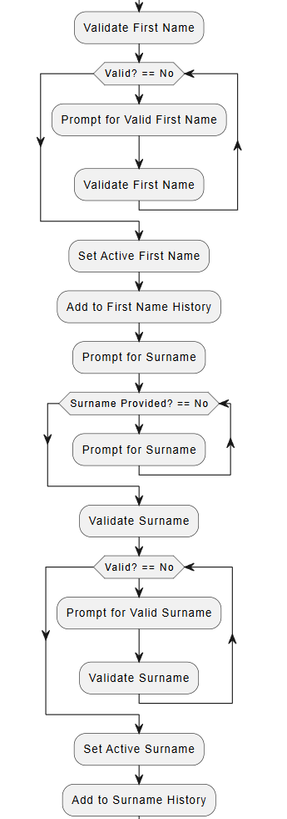
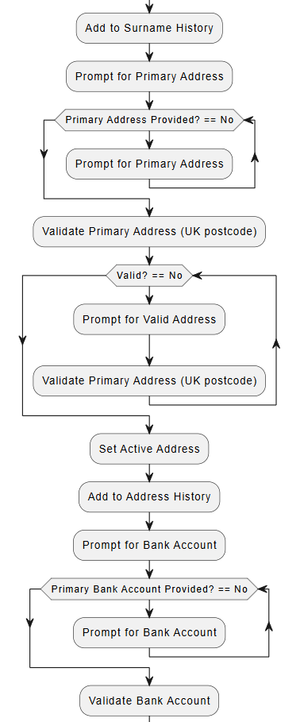

Slide 10
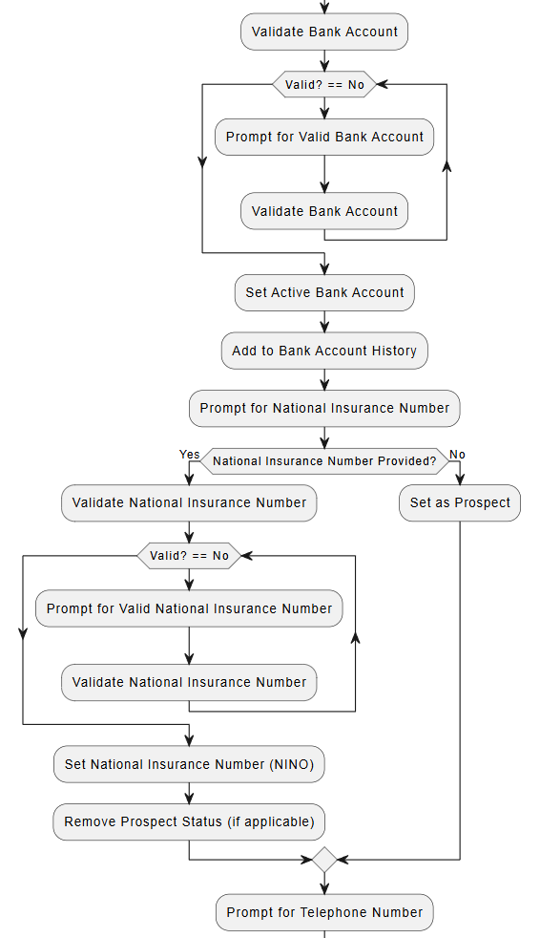
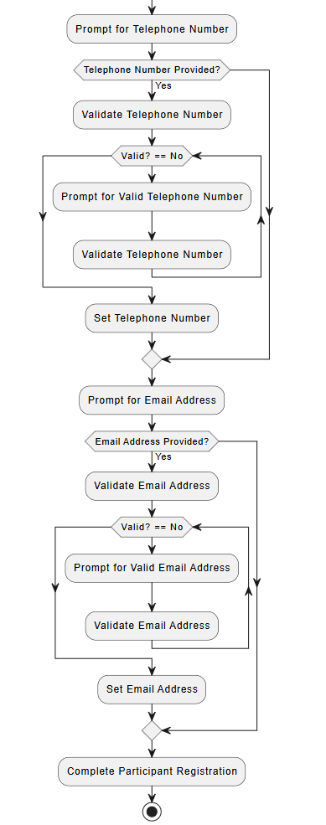

Slide 11
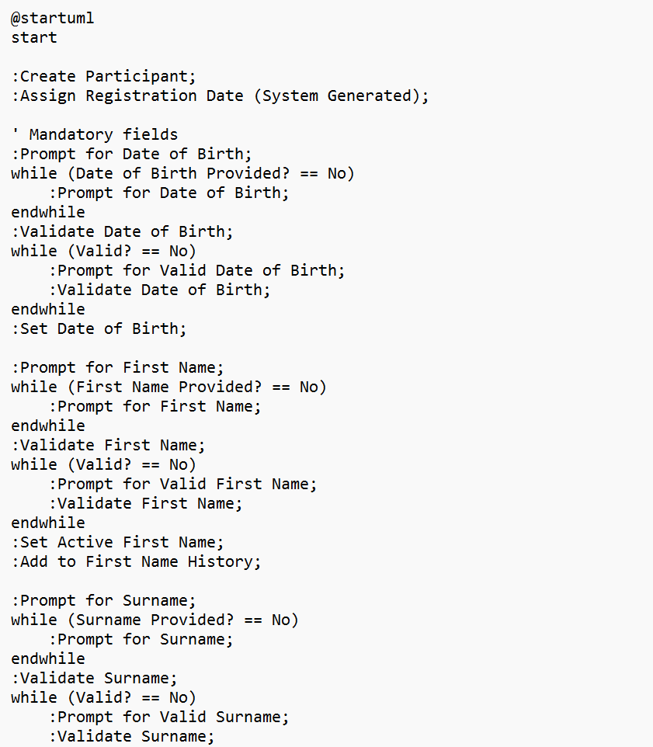
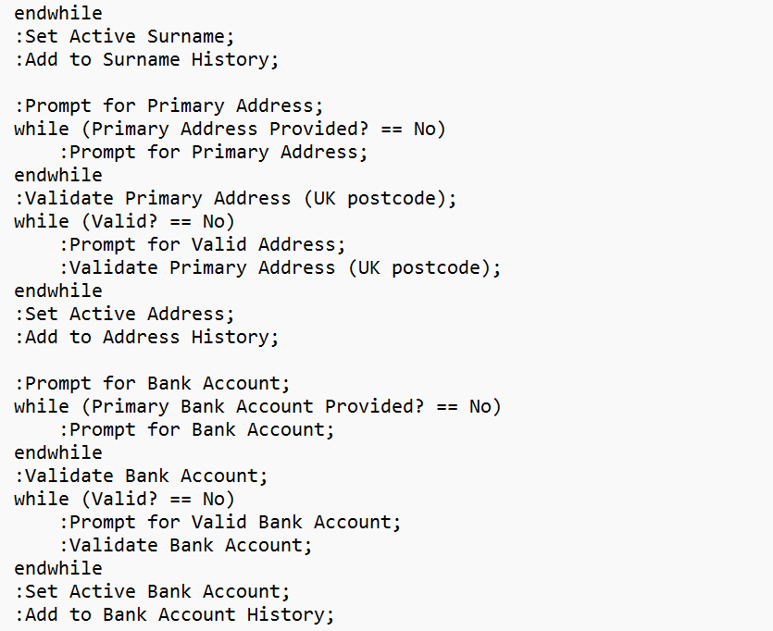
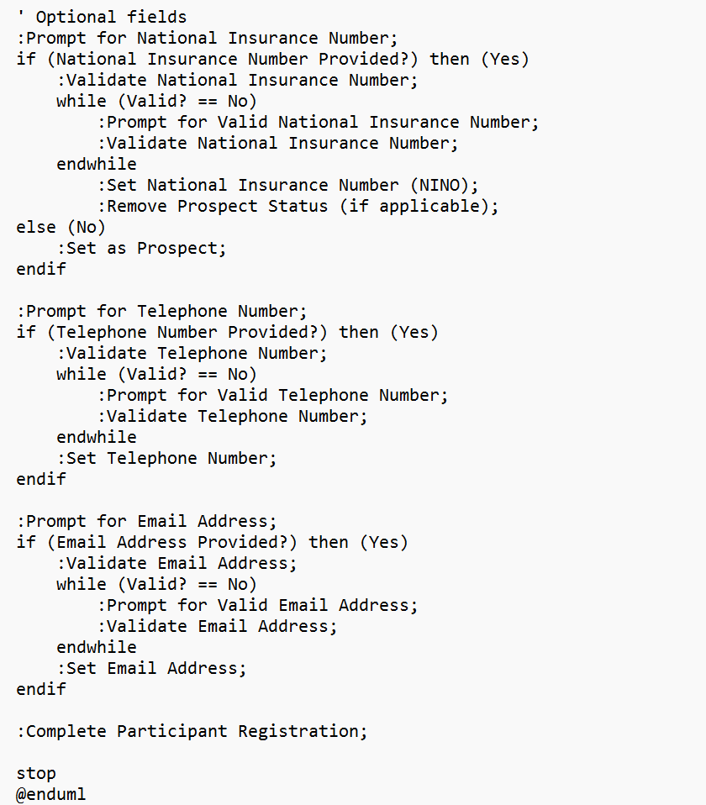

Slide 12
Activity Diagram
Step-by-step creation of a Participant
Prompting and data validation at each step
Handling optional and mandatory fields differently
Preservation of historical data using Evidence

Slide 13
Acceptance Criteria
Attribute | Requirement
Registration Date | Mandatory, auto-generated, read-only
National Insurance Number | Optional, validated, set as "Prospect" if absent, editable
Date of Birth | Mandatory, validated, editable
First Name & Surname | Mandatory, validated, active values are editable, historical data tracked
Primary Address | Mandatory, validated (UK post code format), active value is editable, historical data tracked
Primary Bank Account | Mandatory, validated, active value is editable, historical data tracked
Telephone | Optional, validated (numbers only), editable
Email | Optional, validated (email format), editable

Slide 14
Key Functionality
Add/Set Operations
addFirstNameToHistoryAndSetAsActive – Adds to history and sets as active
addSurnameToHistoryAndSetAsActive – Same for surname
addAddressToHistoryAndSetAsActive – Same for address
addBankAccountToHistoryAndSetAsActive – Same for bank account
Prospect Handling
Prospect set if no NINO, removed when NINO added
Data Validation
Custom validation for format (using regex) and uniqueness

Slide 15
Testing Approach
Unit Testing Strategy:
Individual tests for each method
Edge cases (e.g., invalid email)
Prevent overwriting of historical data
Test Coverage
Constructor Tests
Getter/Setter Tests
Business Logic Tests
Edge Cases (Invalid Inputs)
Sample Tests
Test setting and retrieving first name
Test adding evidence and tracking history
Test NINO-based prospect status handling

Slide 16
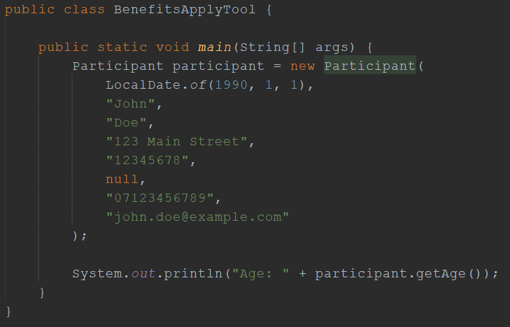
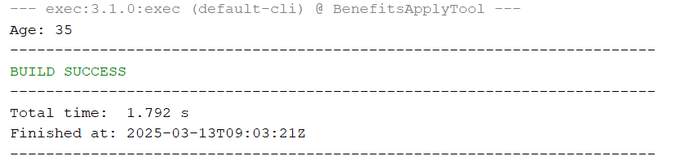
Use Case Example

Slide 17
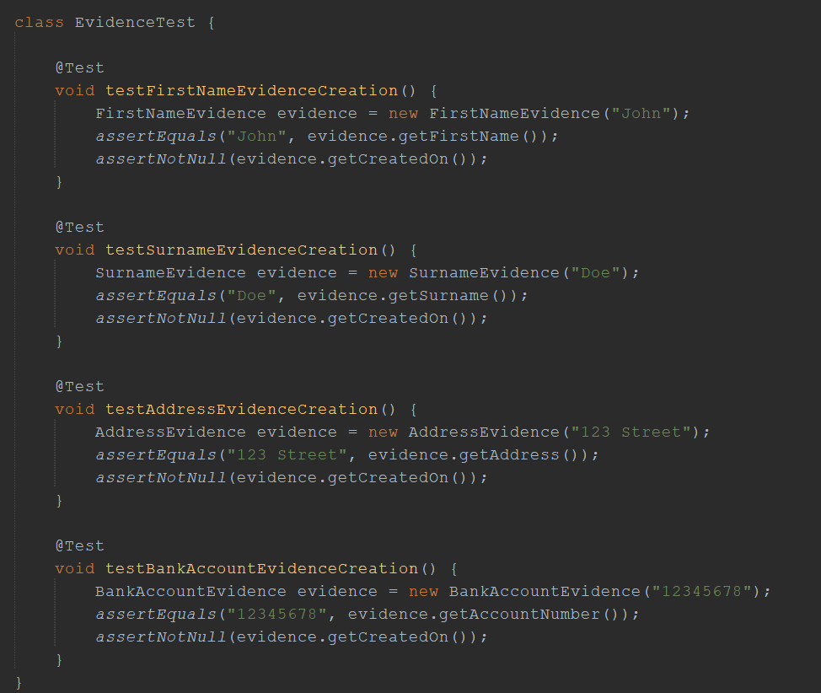
JUnit Test: EvidenceTest

Slide 18
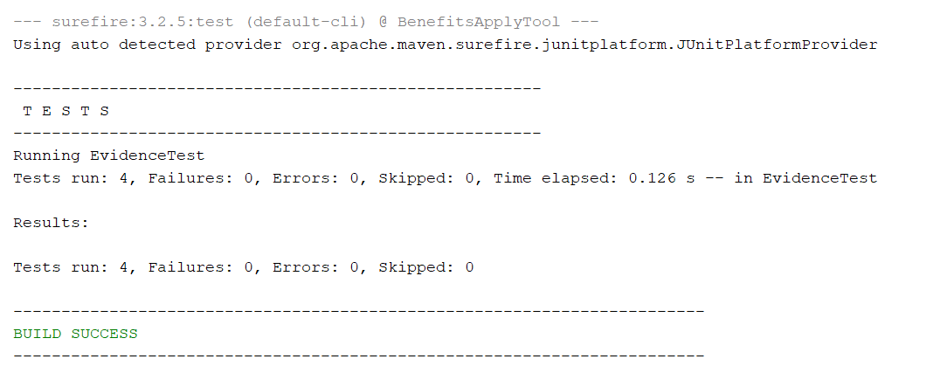
JUnit Test Results: EvidenceTest

Slide 19
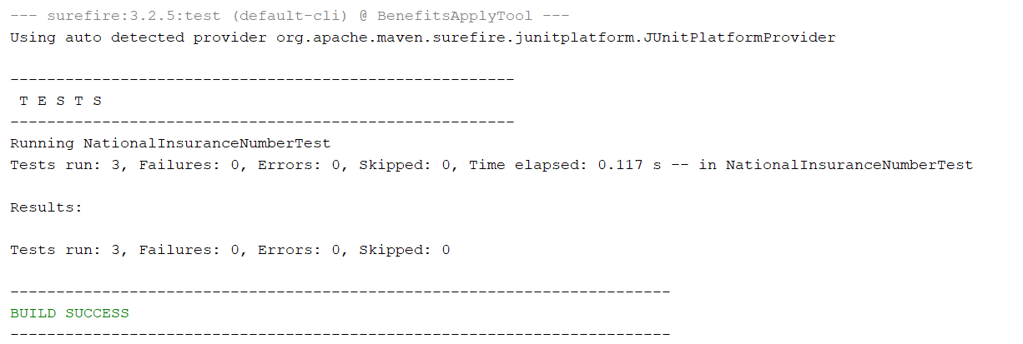
JUnit Test Results: NationalInsuranceNumberTest

Slide 20
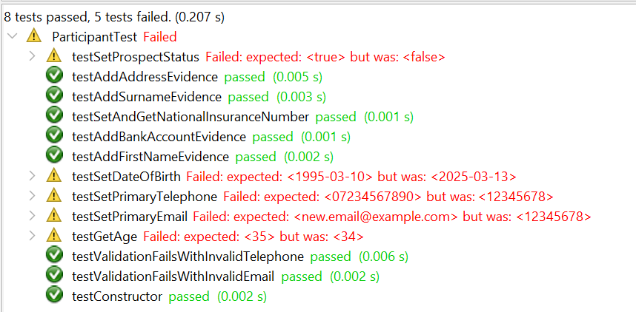
JUnit Test Results: ParticipantTest

Slide 21
Challenges & Future Improvements
Ensuring All Tests Pass
Challenge: Ensuring comprehensive test coverage and passing of all tests
Future Improvement: Debugging and fixing existing bugs caught by failing of tests
Synchronise UML Diagrams to Implementation
Challenge: Not all design aspects map directly to implementation
Future Improvement: Ensure accurate translation of UML diagrams to the implementation

Slide 22
Q&A
Thank you for listening!

